Slide 1



Python for Data Analysis
Landslide after Rainfall
Victor QIAN
Martin RAMPONT

Slide 2


01
Subject introduction
Landslide after Rainfall - An Understudied Field

Slide 3
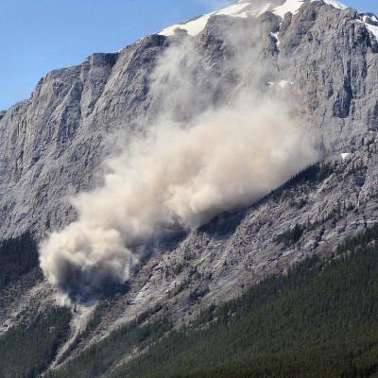
Landslide after Rainfall
Thousands deaths
Billions $ damages
/ Each year

Slide 4
Use cases of Landslide Analysis
Landslide Suceptibility
Early warning system
Impact Assessment
Identify areas that are prone to landslides
+ map in real time
Provide timely warnings to residents and authorities.
Assess the extent of damage and plan for recovery
(Computer Vision)

Slide 5
02
The Dataset
Global Landslide Catalog Export (2007-2016), NASA

Slide 6
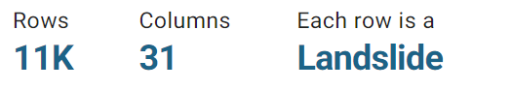
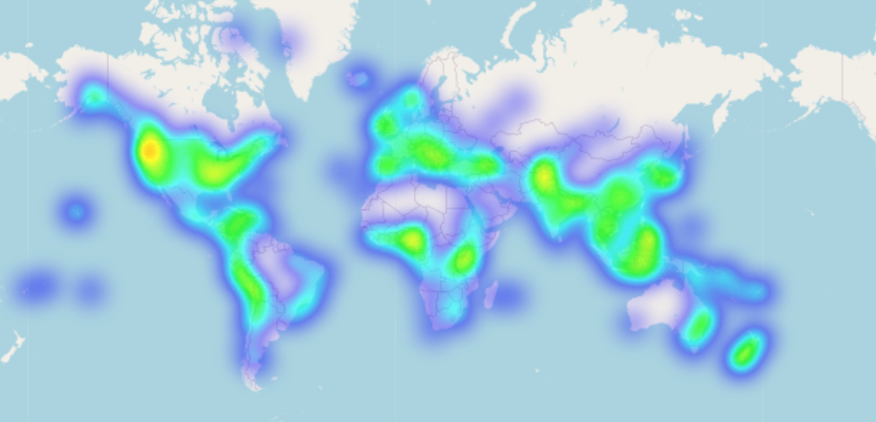
Global Landslide Catalog Export (2007-2016), NASA

Slide 7
03
EDA
ASL Recognition

Slide 8
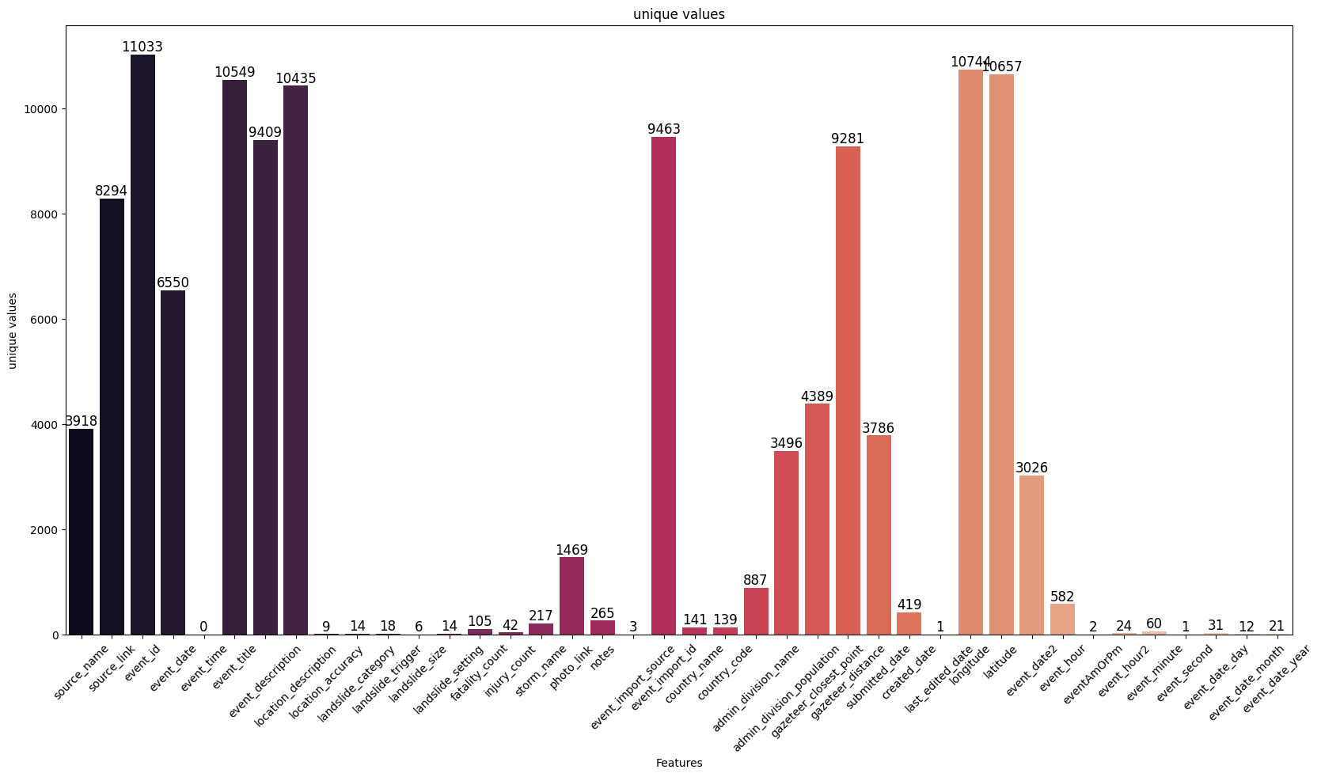
Missing values

Slide 9
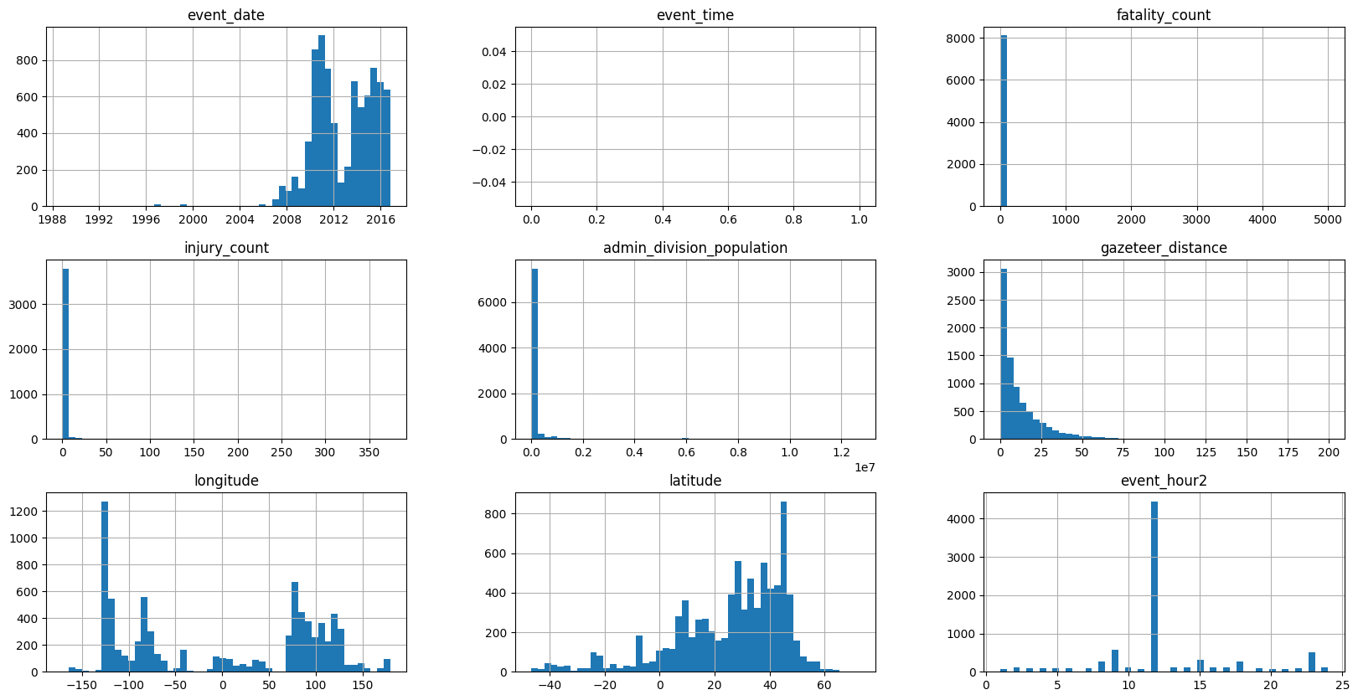
Distribution / outliers

Slide 10
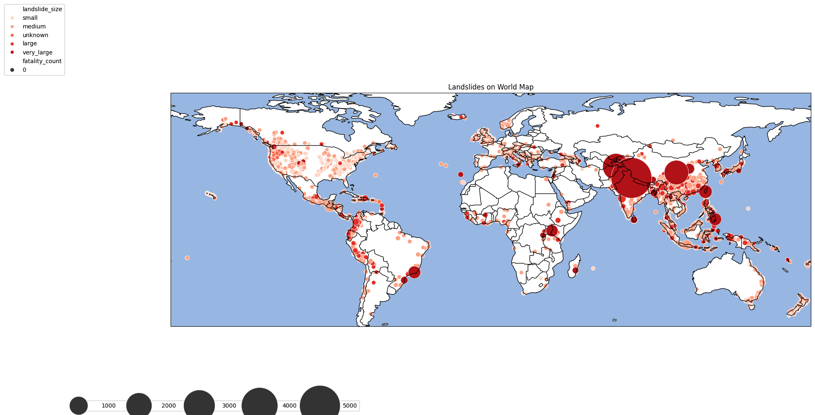
Map of Fatality Count

Slide 11
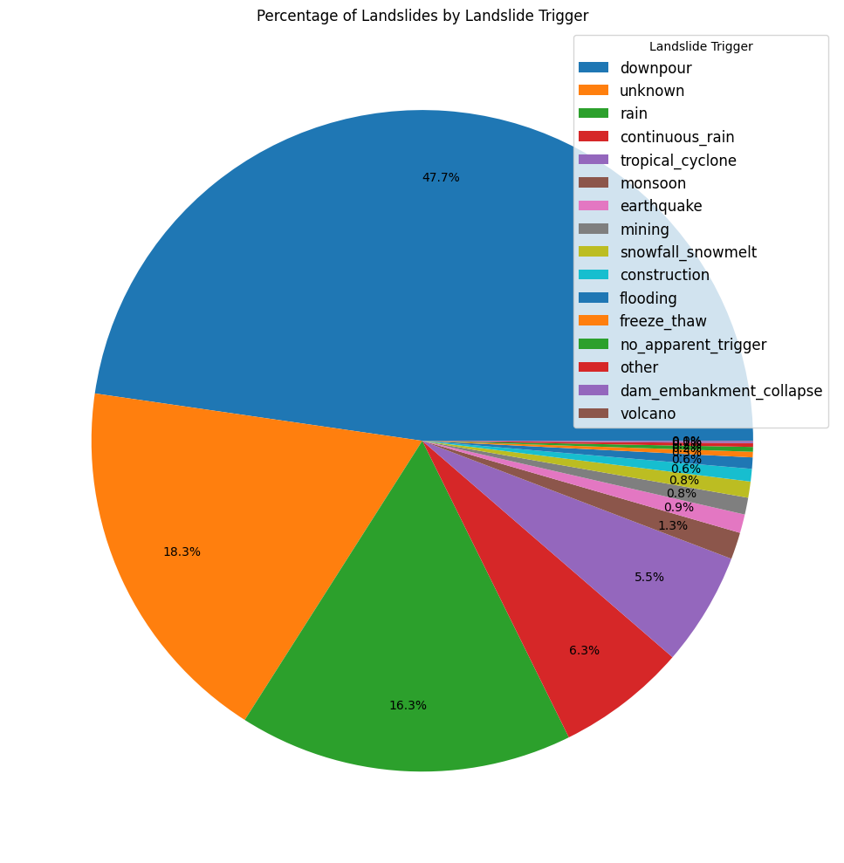
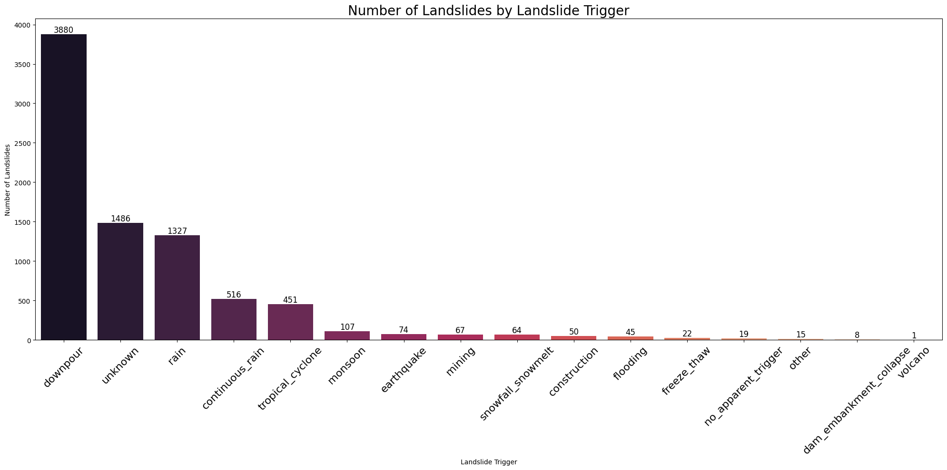
Triggers
By Month
By Year

Slide 12
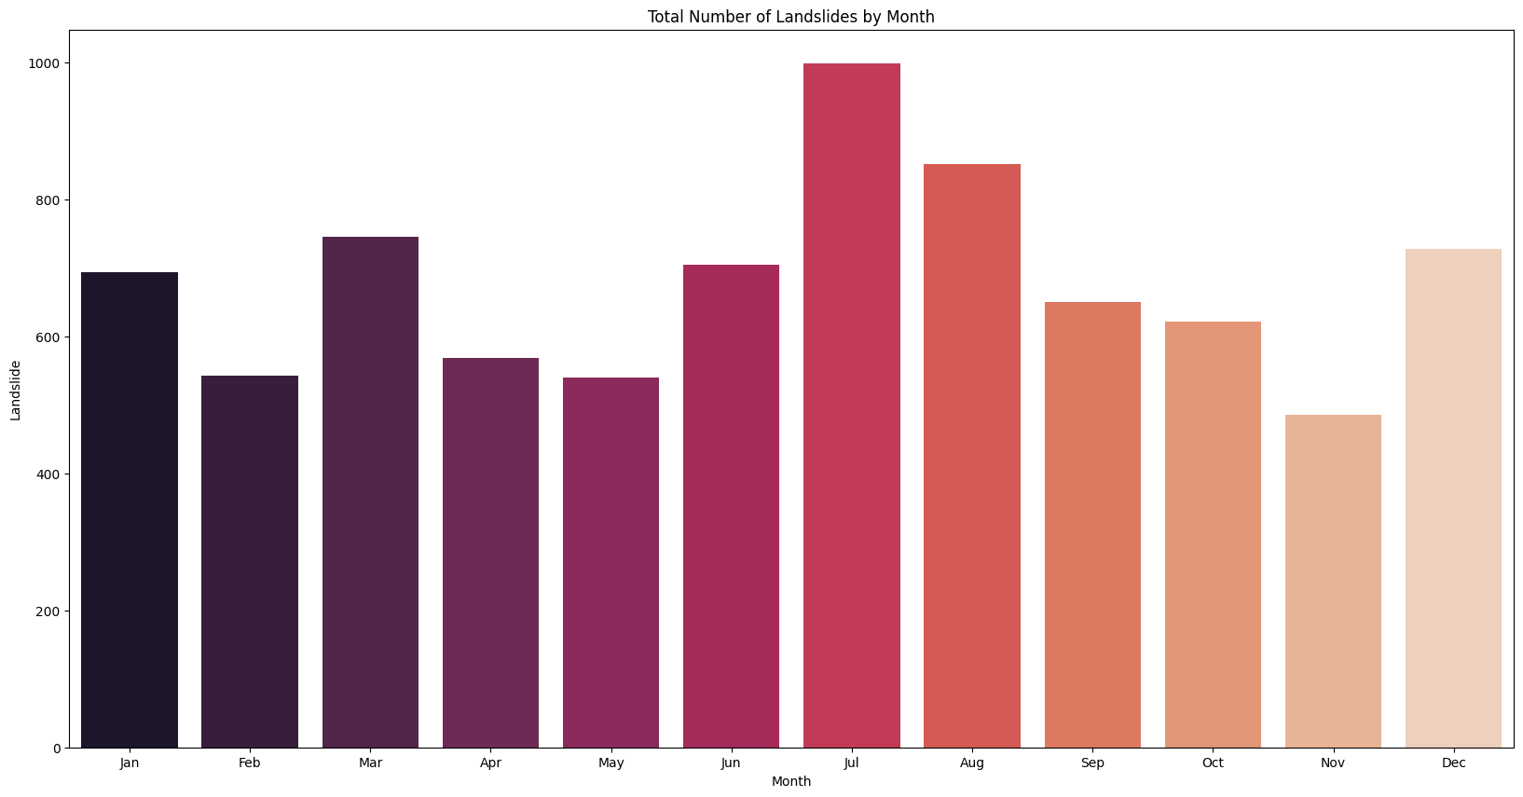
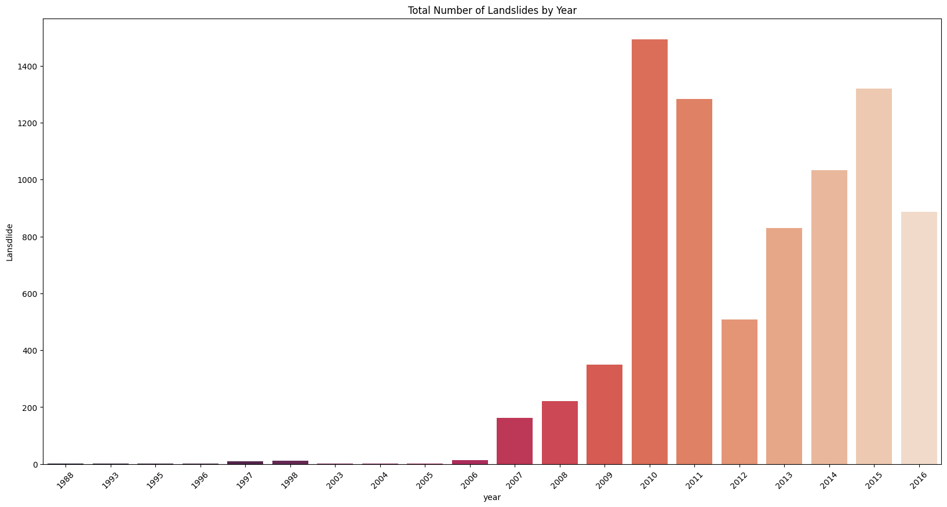
Time Seasonality
By Month
By Year

Slide 13
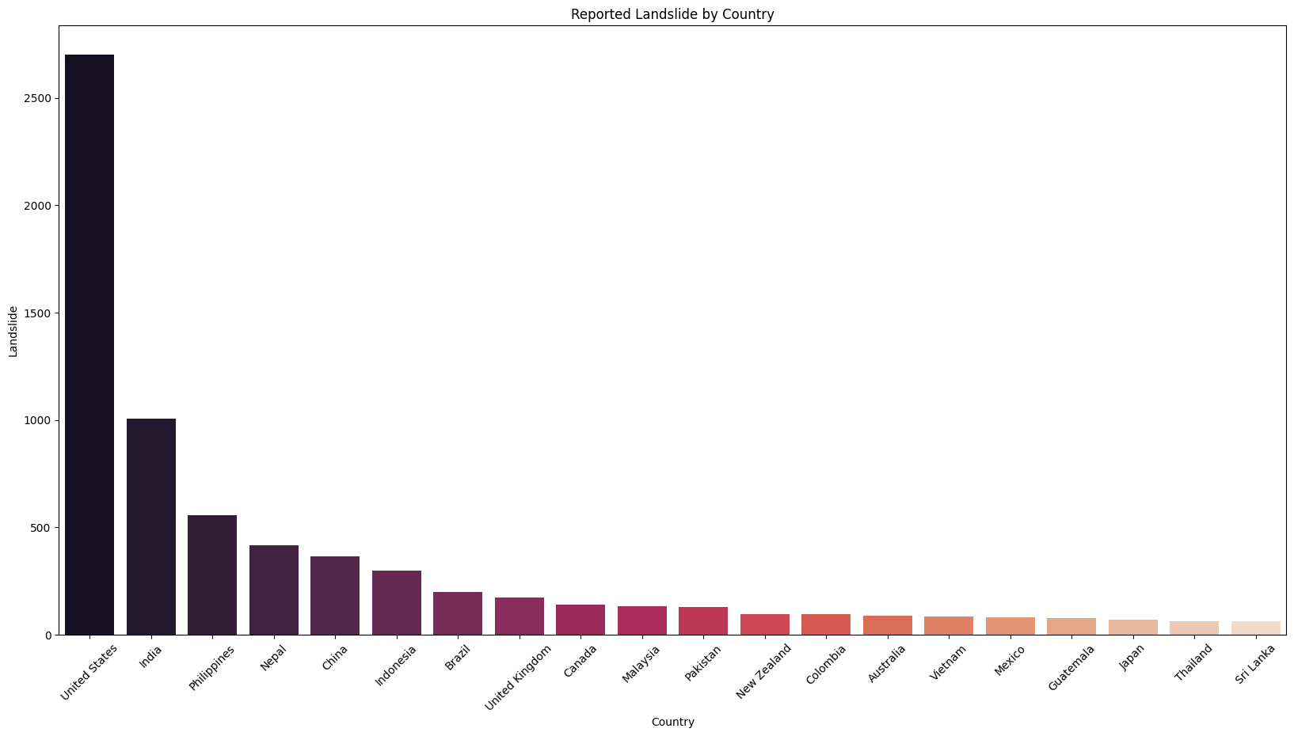
Country Landslide Number

Slide 14
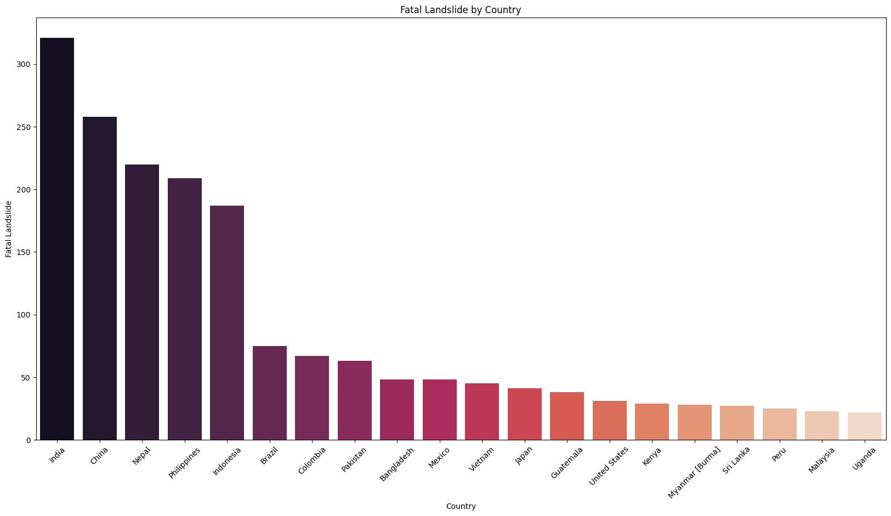
Country deaths number

Slide 15
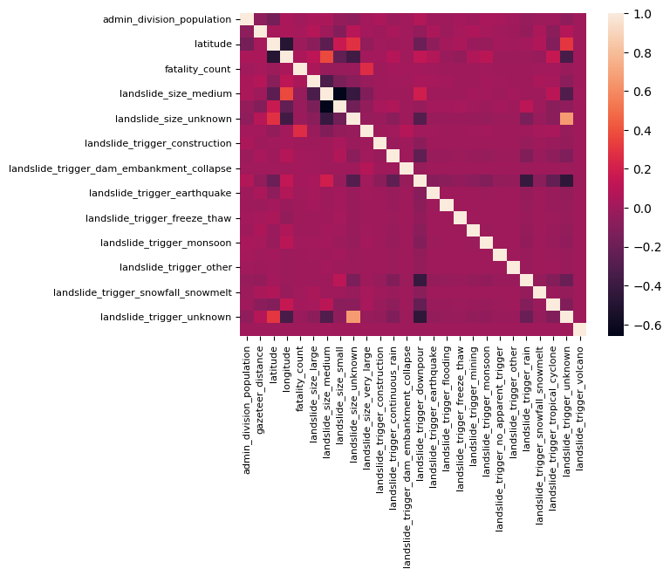
Correlation

Slide 16
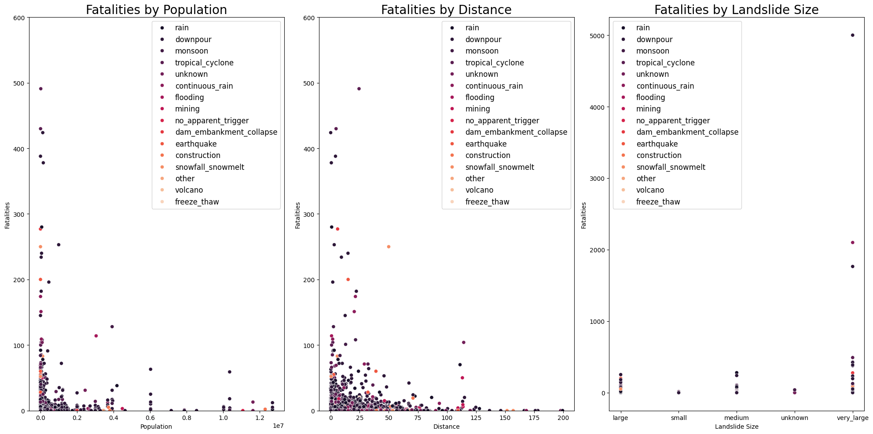
Correlation

Slide 17
04
Machine Learning
ASL Sign Language Recognition

Slide 18
Data Preprocessing
Incorrect data types and values
Final output
Values Formating
Normalization
Missing Values
Columns Splitting
Deals with missing values
Time data splitting

Slide 19
Types of trained models
AI model | Advantages | Drawbacks
Random Forest | Handles non-linearity and interactions well | Can be prone to overfitting, especially on noisy data
Random Forest Tuned (Grid Search) | Improved performance through hyperparameter tuning | Increased computational cost due to tuning
SVR | Effective in high-dimensional spaces | Sensitive to noise and may require careful preprocessing
SVR Tuned | Better generalization with optimized parameters | Computationally expensive, especially with grid search
Linear Regression | Simple and interpretable | Assumes a linear relationship, may not capture complex patterns
Neural Network | Powerful for complex, non-linear relationships | Requires large amounts of data and computation resources
Tensorflow | Comprehensive deep learning framework | Steeper learning curve, especially for beginners
Xgboost | Handles missing values and outliers well | Prone to overfitting, may require tuning

Slide 20
05
Results
ML Results

Slide 21
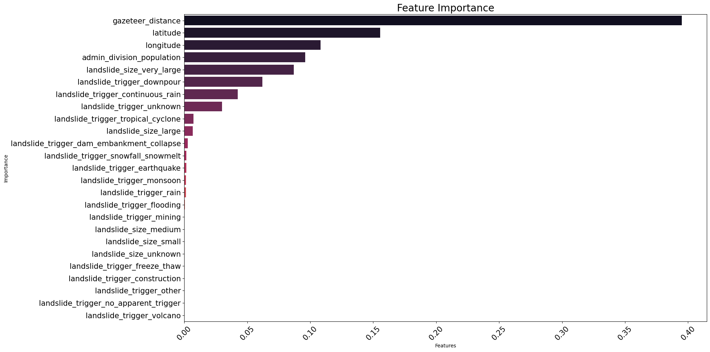
Results

Slide 22
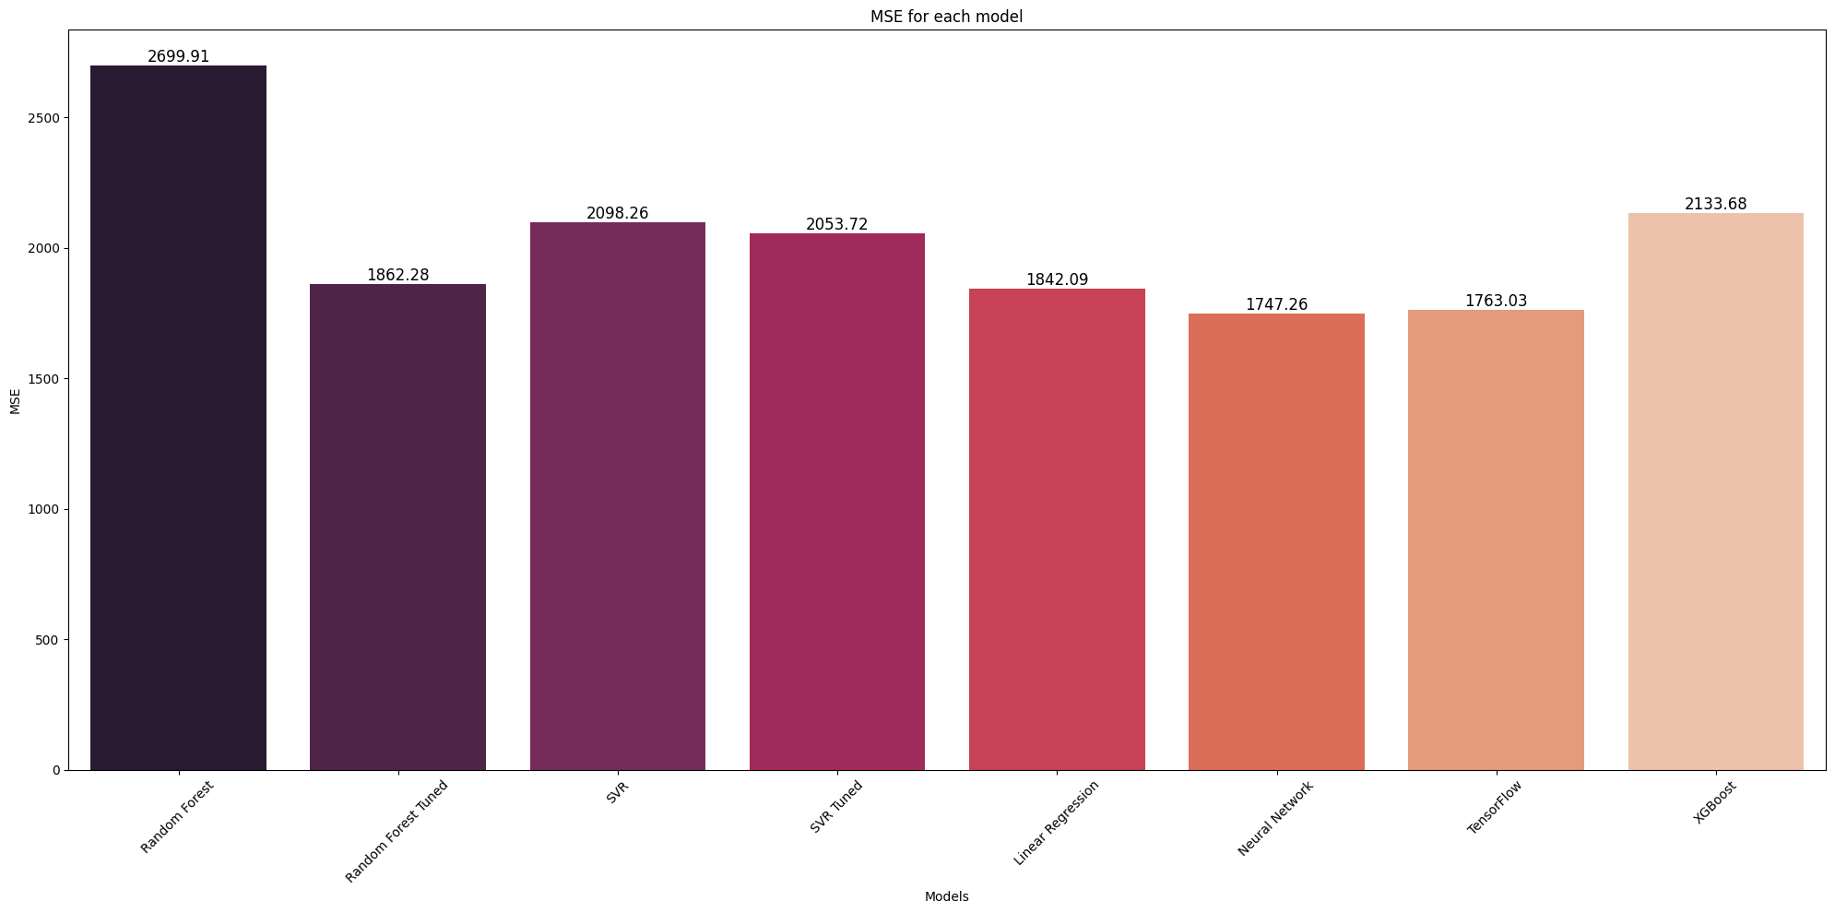
Results

Slide 23
06
Streamlit App
Project summary

Slide 24
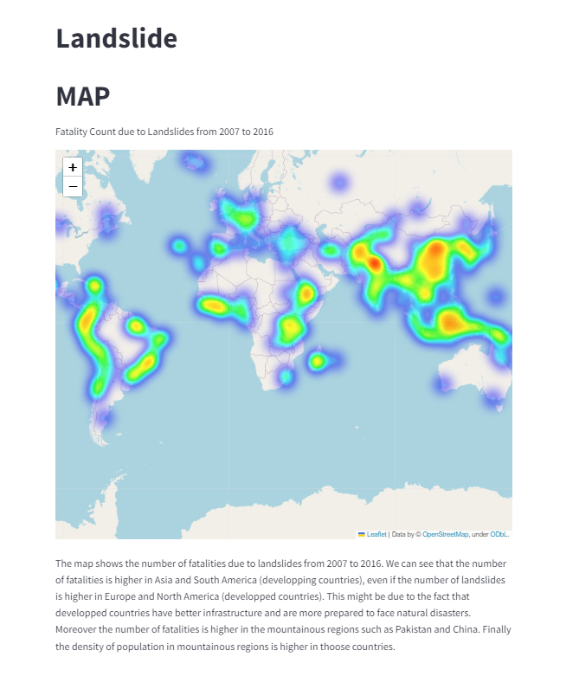
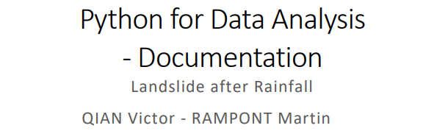
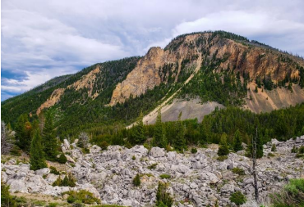
Streamlit App
Streamlit App
Homepage
Data Analysis
ML
Map
Documentation

Slide 25
THANKS!
DO YOU HAVE ANY QUESTIONS ?

